Slide 1

Othello in Pygame
Richard Gresham

Slide 2
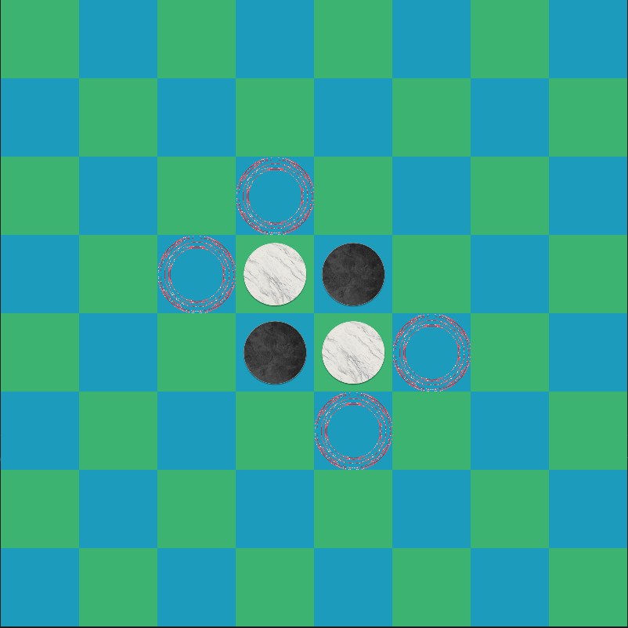
Othello Rules
Resembles the game of checkers with white and black checker pieces
Board starts off with two black and white pieces in the center of the board with white and black pieces diagonally placed.
Concept is that players place pieces down to ‘flank’ opponents' pieces on both sides to convert it to theirs's.
You are only allowed to place pieces where you can flank and opponent piece, And when both players cannot put down anymore pieces the game is over, the one with more pieces on the board wins.

Slide 3
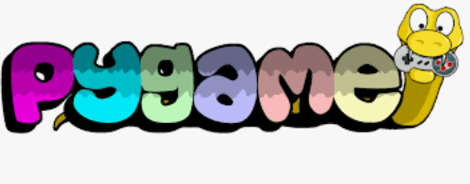
Othello Game Visuals
Created and made via Pygame commands.
Used commands such as Rect() to create a visual representation of our game and allow user interaction.
User interaction comes from commands such as pygame.mouse.get_pressed[0] to take input from mouse and keyboard.

Slide 4
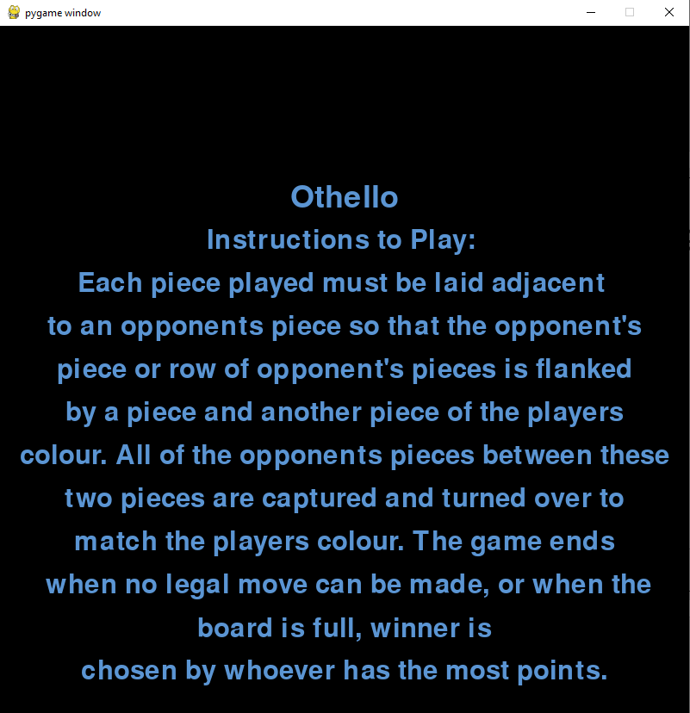
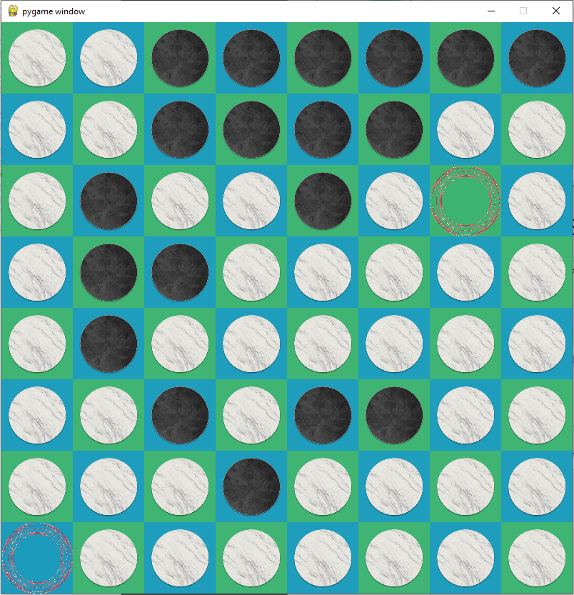
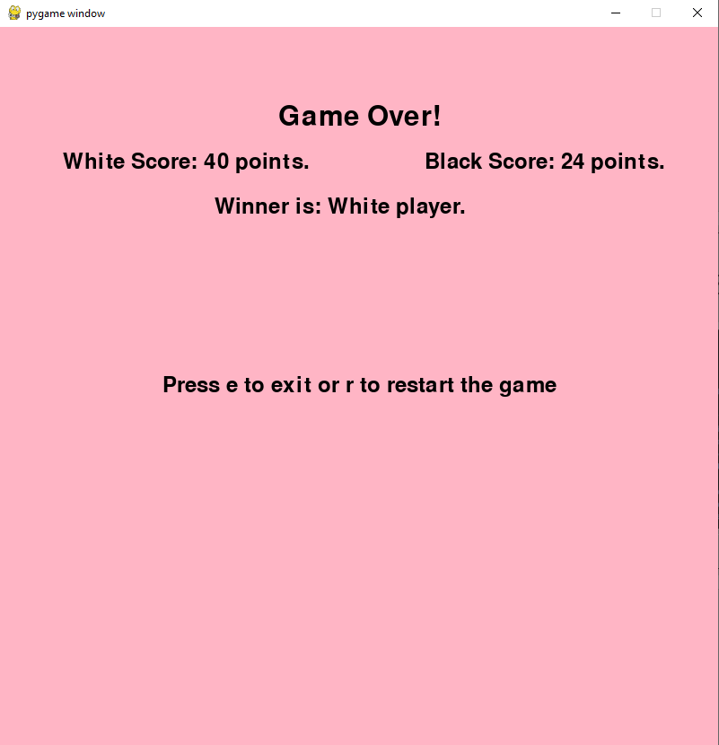
Game Scenes

Slide 5
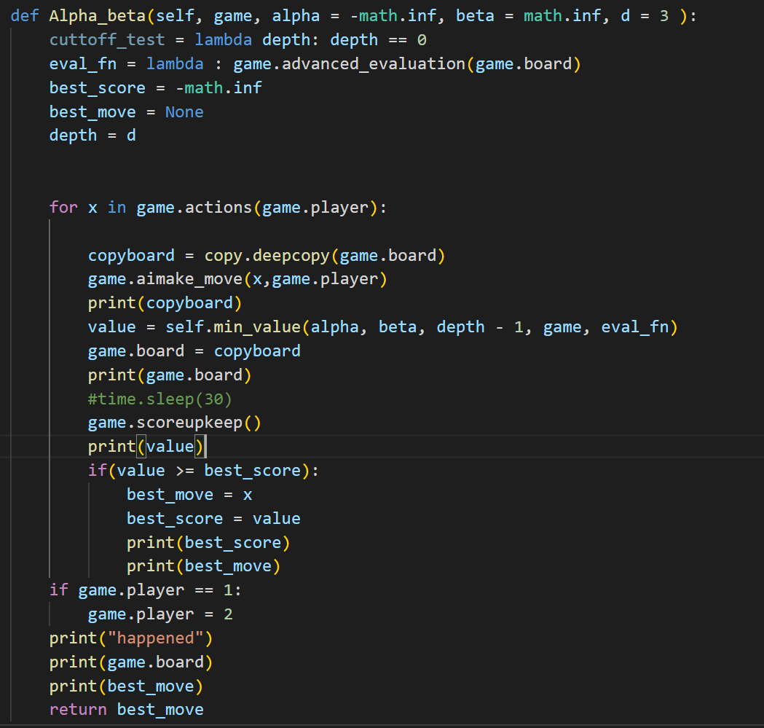
Othello(Problem) – Alpha-Beta Algorithm.
Main problem for this project was the creation of an alpha beta ai for the player to play against.
Main parts of the alpha beta ai was the evaluation function, depth and min and max functions.
Depth Limited so the Ai doesn’t take forever to complete it’s turn.

Slide 6
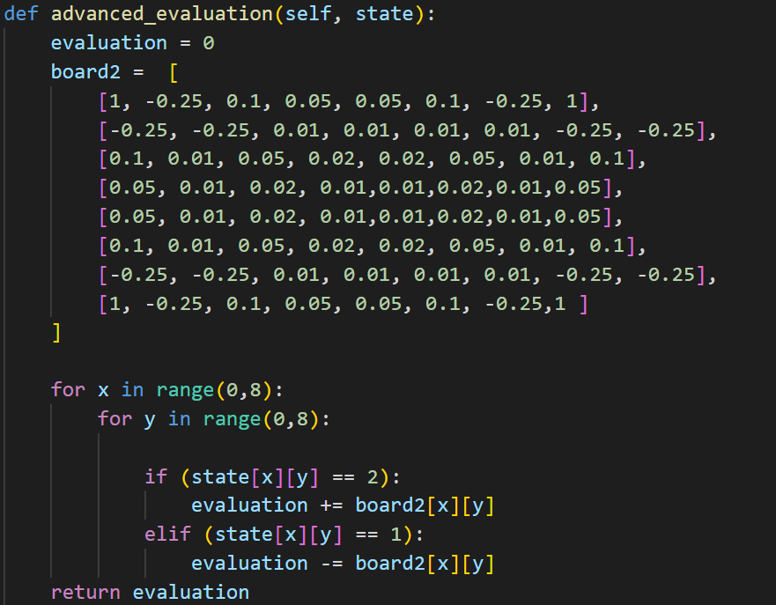
Evaluation Function
Board 2 within the advanced evaluation function is our estimate which will help our ai produce the decision as to what valid move it should make.
Points were assigned based upon the advantage one would have if they were to take that specific action.
This will affect the ai decision as to what move it should make.

Slide 7
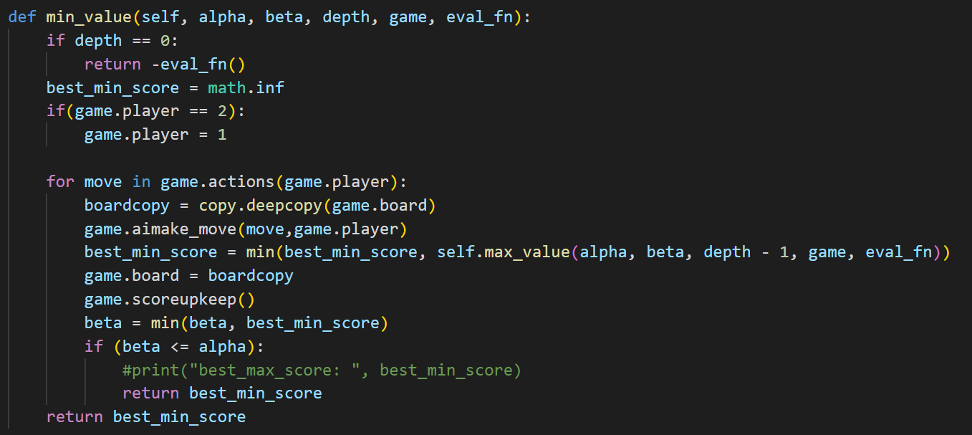
Min-value function
This min_value function is called in the alpha-beta function and is used to return the best minimum score.
This function loops through all valid moves unless our depth becomes zero toward which it will return –eval_fn() which is our evaluation function.
Deep copies are needed while running through our min and max functions to return our board state to its original state prior to running the alpha beta function.

Slide 8
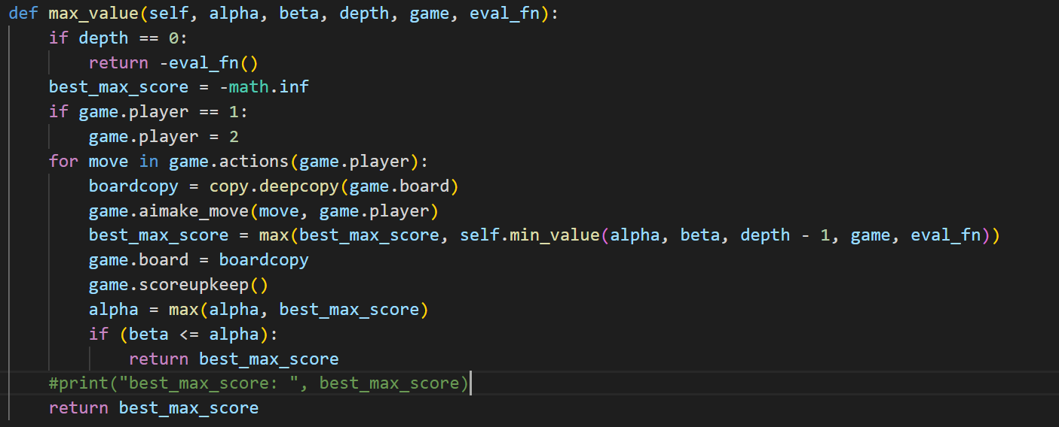
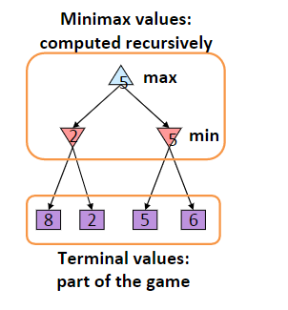
Max-Value function
This max_value function is called within the alpha-beta function and finds the best maximum score.
As you can see in both max-value and min-value functions they call each other with the depth decreasing by one per call.
This is because as the depth grows, the players turn alternate.
As the depth hits 0 and all valid moves are finished the best move is chosen and initiated on the board.

Slide 9
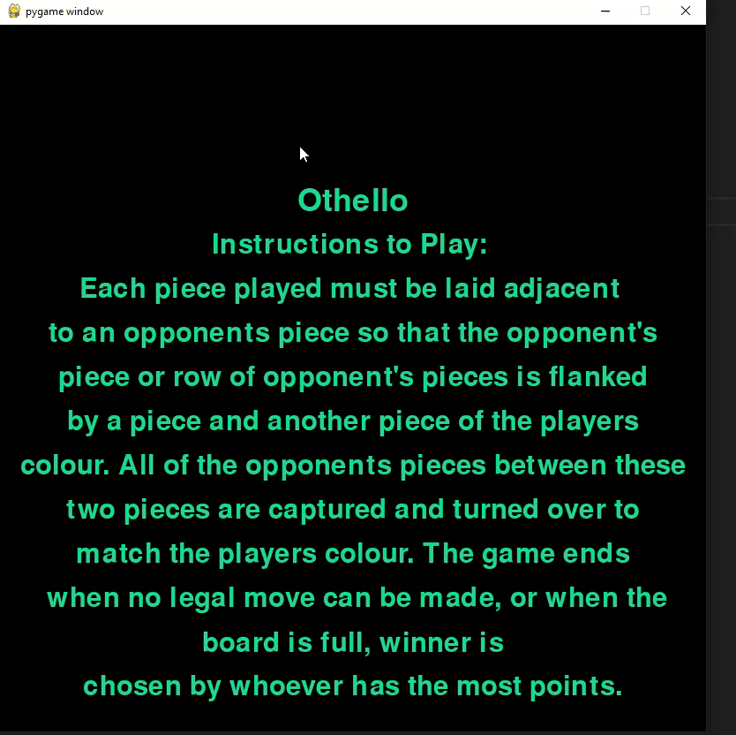
Test Video

Slide 10
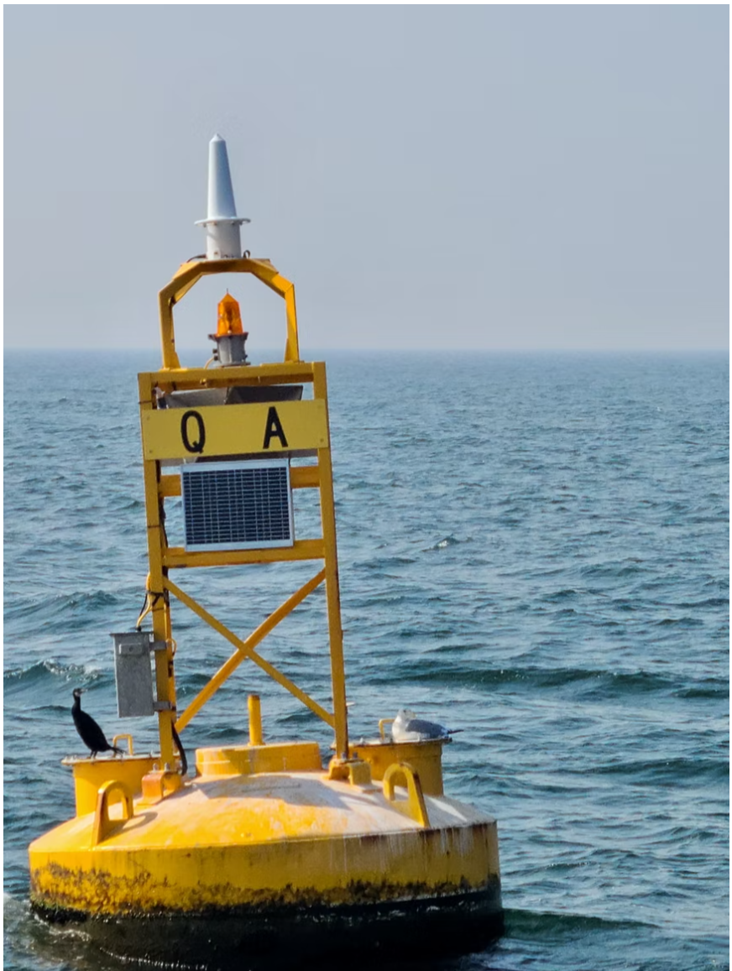
Q&A

